Slide 1
Logic Gates
A gate is a device that performs a basic operation on electrical signals.
Gates are combined into circuits to perform more complicated tasks.

Slide 2
Logic Gates
There are three different, but equally powerful, notational methods for describing the behavior of gates and circuits
Boolean expressions
logic diagrams
truth tables

Slide 3
Logic Gates
Boolean algebra: expressions in this algebraic notation are an elegant and powerful way to demonstrate the activity of electrical circuits

Slide 4
Logic Gates
Logic diagram: a graphical representation of a circuit
Each type of gate is represented by a specific graphical symbol
Truth table: defines the function of a gate by listing all possible input combinations that the gate could encounter, and the corresponding output.

Slide 5
Gates
Types of gates
NOT
AND
OR
XOR
NAND
NOR
Typically, logic diagrams are black and white, and the gates are distinguished only by their shape

Slide 6
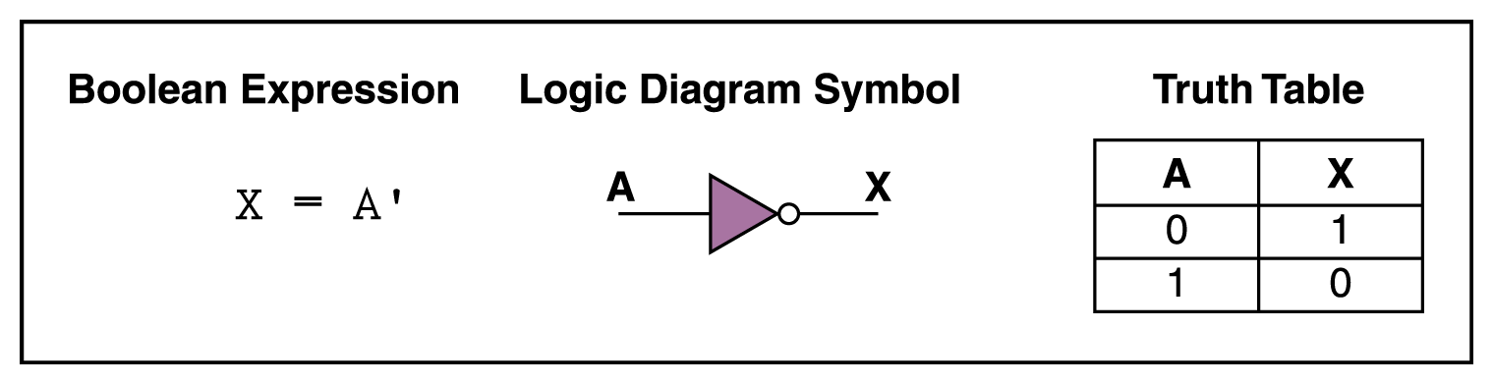
NOT Gate
A NOT gate accepts one input value and produces one output value

Slide 7
NOT Gate
By definition, if the input value for a NOT gate is 0, the output value is 1, and if the input value is 1, the output is 0
A NOT gate is sometimes referred to as an inverter because it inverts the input value

Slide 8
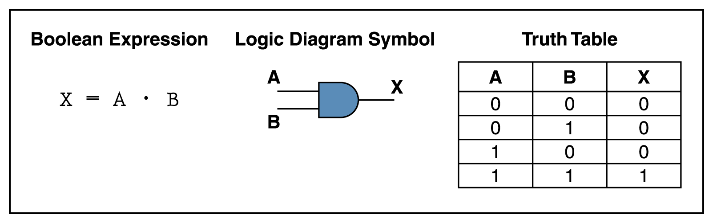
AND Gate
An AND gate accepts two input signals
If the two input values for an AND gate are both 1, the output is 1; otherwise, the output is 0

Slide 9
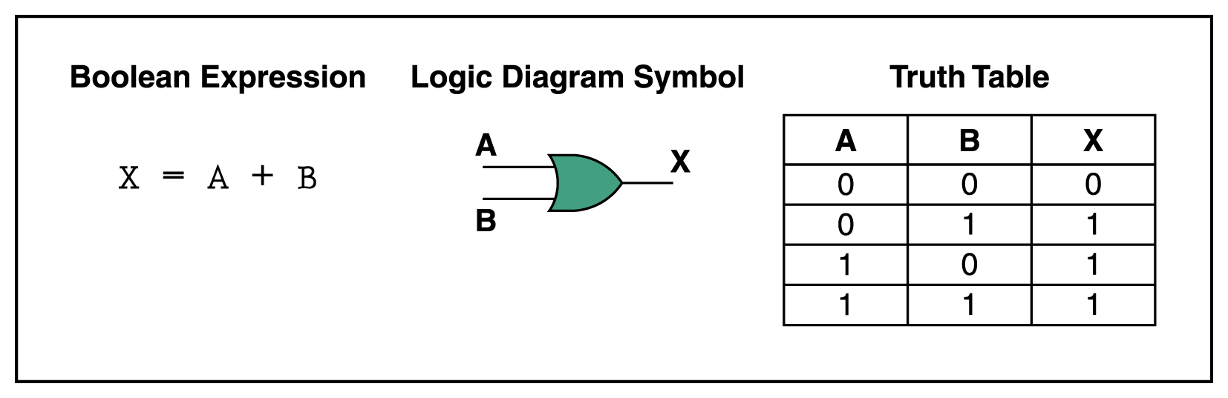
OR Gate
If the two input values are both 0, the output value is 0; otherwise, the output is 1

Slide 10
XOR Gate
XOR, or exclusive OR, gate
An XOR gate produces 0 if its two inputs are the same, and a 1 otherwise
Note the difference between the XOR gate and the OR gate; they differ only in one input situation
When both input signals are 1, the OR gate produces a 1 and the XOR produces a 0

Slide 11
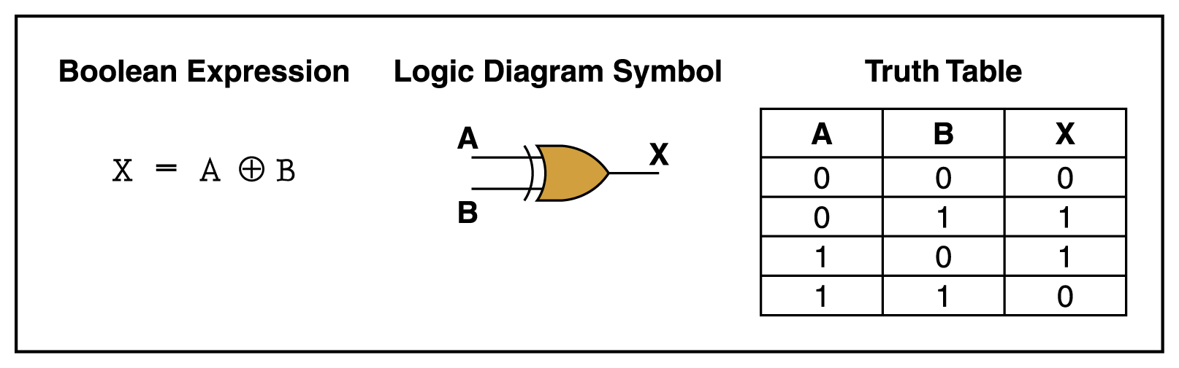
XOR Gate

Slide 12
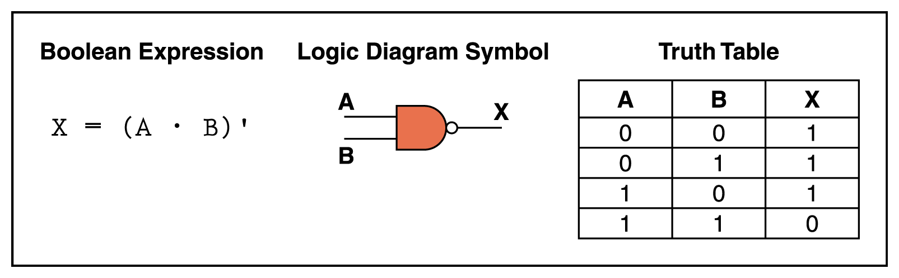
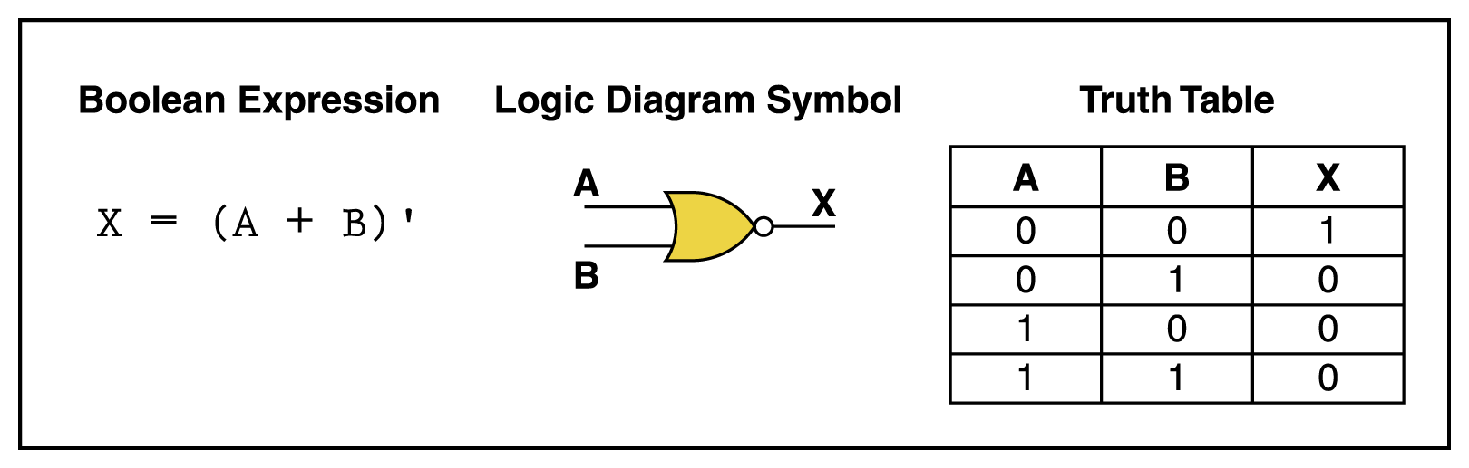
NAND and NOR Gates
The NAND and NOR gates are essentially the opposite of the AND and OR gates, respectively

Slide 13
Review of Gate Processing
A NOT gate inverts its single input value
An AND gate produces 1 if both input values are 1
An OR gate produces 1 if one or the other or both input values are 1

Slide 14
Review of Gate Processing (cont.)
An XOR gate produces 1 if one or the other (but not both) input values are 1
A NAND gate produces the opposite results of an AND gate
A NOR gate produces the opposite results of an OR gate

Slide 15
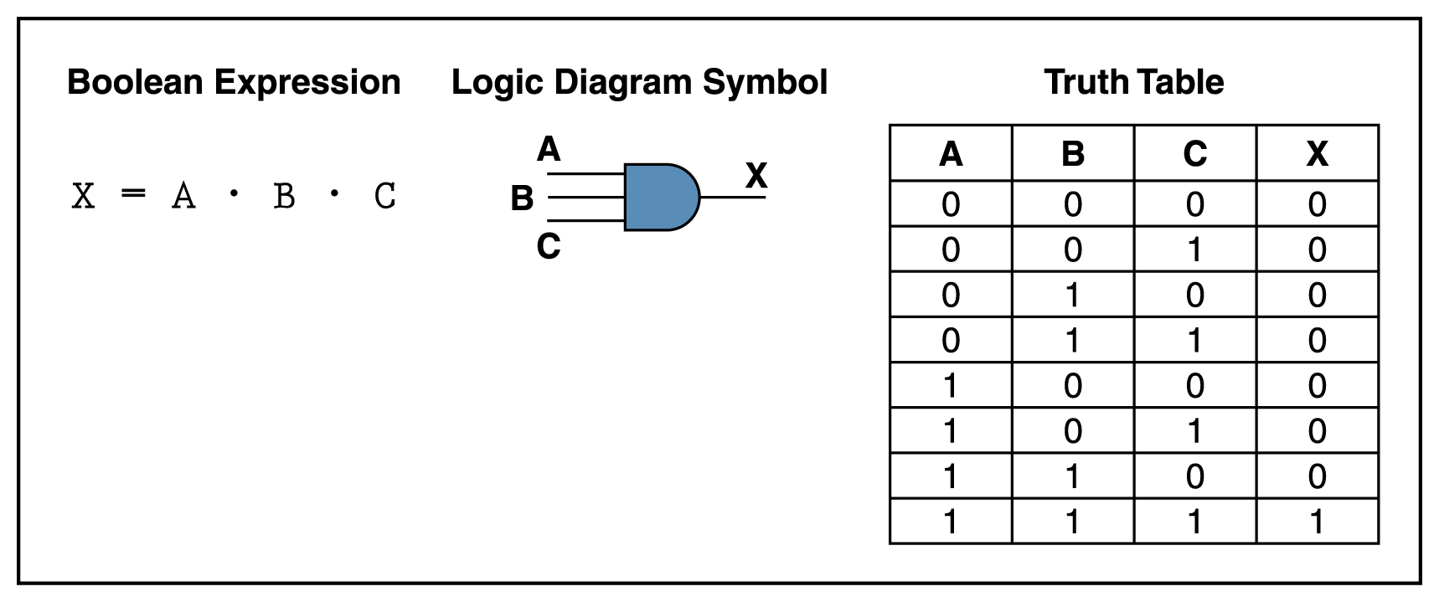
Gates with More Inputs
Gates can be designed to accept three or more input values
A three-input AND gate, for example, produces an output of 1 only if all input values are 1

Slide 16
Types of Logic Gates

Slide 17
DeMorgan’s Theorems
DeMorgan’s Theorems are two additional simplification techniques that can be used to simplify Boolean expressions. Again, the simpler the Boolean expression, the simpler the resulting logic.
Notes:
Introductory Slide / Overview of Presentation

Slide 18


DeMorgan’s Theorem #1
Proof
0 | 0 | 0 | 1
0 | 1 | 0 | 1
1 | 0 | 0 | 1
1 | 1 | 1 | 0
0 | 0 | 1 | 1 | 1
0 | 1 | 1 | 0 | 1
1 | 0 | 0 | 1 | 1
1 | 1 | 0 | 0 | 0
The truth-tables are equal; therefore, the Boolean equations must be equal.
Notes:
Overview & proof of DeMorgan’s Theorem #1

Slide 19
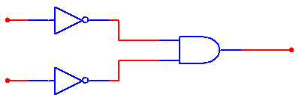

DeMorgan’s Theorem #2
Proof
0 | 0 | 0 | 1
0 | 1 | 1 | 0
1 | 0 | 1 | 0
1 | 1 | 1 | 0
0 | 0 | 1 | 1 | 1
0 | 1 | 1 | 0 | 0
1 | 0 | 0 | 1 | 0
1 | 1 | 0 | 0 | 0
The truth-tables are equal; therefore, the Boolean equations must be equal.
Notes:
Overview & proof of DeMorgan’s Theorem #2

Slide 20
Boolean Equations
All Boolean Equations are written in one of two formats:
• SOP (Sum of Products) – (AND) OR (AND) OR … OR (AND)
• POS (Product of Sums ) – (OR) AND (OR) AND … AND (OR)

Slide 21
Boolean Equations
Use Boolean Theorems and Postulates, DeMorgan’s Theorem, or the Karnaugh Map to reduce the number of gates
– Decreases cost
– Increases reliability

Slide 22
Boolean Laws
OR Identities AND Identities
A + 0 = A A * 0 = 0
A + 1 = 1 A * 1 = A
A + A = A A * A = 0
A + A = 1 A * A = A

Slide 23
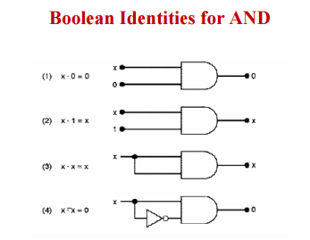

Slide 24
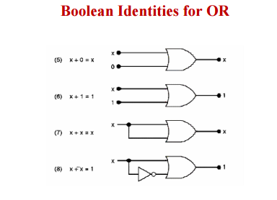

Slide 25
De-Morgan’s Theorem and Logic Conversion
1)
2)
3)
4)

Slide 26
Implement the logic expression using NAND gates only
1)
2)

Slide 27
Implement logic expression using NOR gates only
1)

